Slide 1
Unit 3:Sequential Circuits
Sequential circuit is the combination of Combinational circuit and memory.
In sequential circuit present output is depending on present input and past output so It acts as a Feedback Mechanism.

Slide 2
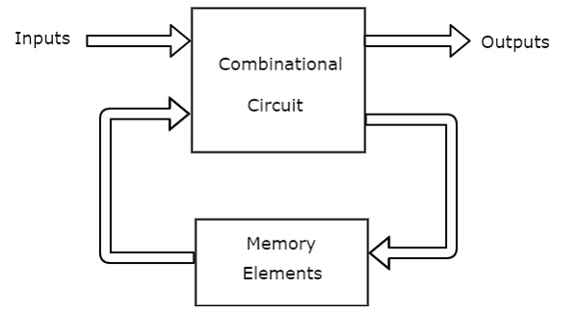
This sequential circuit contains a set of inputs and outputs. The outputs of sequential circuit depends not only on the combination of present inputs but also on the previous outputs. Previous output is nothing but the present state. Therefore, sequential circuits contain combinational circuits along with memory storage elements. Some sequential circuits may not contain combinational circuits, but only memory elements.

Slide 3
What is Clock?
In Sequential circuits, many processes are going on and the output of circuit is the input of other. Thus their should be control over the processes. They can not Operate Randomly.
clock signal as a particular type of signal that oscillates between a high and a low state.
We can represent the clock signal as a square wave, when both its ON time and OFF time are same. This clock signal is shown in the following figure.

Slide 4
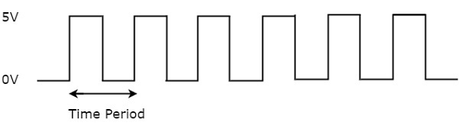
square wave is considered as clock signal.
This signal stays at logic High 5V for some time and stays at logic Low 0V for equal amount of time. This pattern repeats with some time period.
The reciprocal of the time period of clock signal is known as the frequency of the clock signal.
All sequential circuits are operated with clock signal.
So, the frequency at which the sequential circuits can be operated accordingly the clock signal frequency has to be chosen.

Slide 5
Types of Triggering
Following are the two possible types of triggering that are used in sequential circuits.
Level triggering
Edge triggering
Level triggering
There are two levels, namely logic High and logic Low in clock signal. Following are the two types of level triggering.
Positive level triggering
Negative level triggering
If the sequential circuit is operated with the clock signal when it is in Logic High, then that type of triggering is known as Positive level triggering. It is highlighted in below figure.

Slide 6
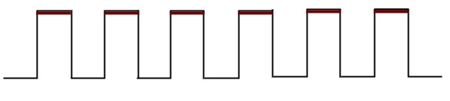
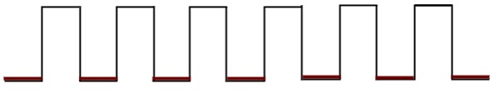
If the sequential circuit is operated with the clock signal when it is in Logic Low, then that type of triggering is known as Negative level triggering. It is highlighted in the following figure.

Slide 7
Edge triggering
There are two types of transitions that occur in clock signal. That means, the clock signal transitions either from Logic Low to Logic High or Logic High to Logic Low.
Following are the two types of edge triggering based on the transitions of clock signal.
Positive edge triggering
Negative edge triggering
If the sequential circuit is operated with the clock signal that is transitioning from Logic Low to Logic High, then that type of triggering is known as Positive edge triggering. It is also called as rising edge triggering. It is shown in the following figure.

Slide 8
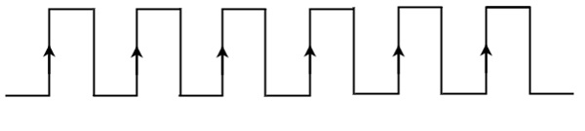
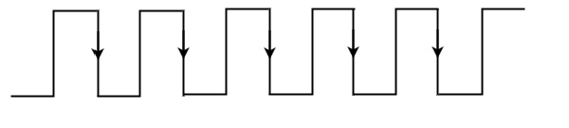
If the sequential circuit is operated with the clock signal that is transitioning from Logic High to Logic Low, then that type of triggering is known as Negative edge triggering. It is also called as falling edge triggering. It is shown in the following figure.

Slide 9
There are two types of memory elements based on the type of triggering that is suitable to operate it.
Latches
Flip-flops

Slide 10
Basics of Flip-Flop and Latches
Flip Flop is a binary storage device.
It can store binary bit either 0 or 1.
It has two stable states high and low i.e 1 and 0
It is also called bistable multivibrator.

Slide 11
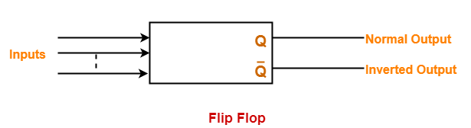
Flip Flop
A flip flop can maintain a binary state for an unlimited period of time as long as-Power is supplied to the circuit.
Or until it is directed by an input signal to switch states.
A flip flop is also called as Bistable Multivibrator because it has two stable states either 0 or 1.

Slide 12
Flip-Flop v/s Latch
The primary difference between a latch and a flip-flop is a gating or clocking mechanism.
In Simple words. Flip Flops are edge-triggered and a latch is level-triggered.
Latches operate with enable signal, which is level sensitive. Whereas, flip-flops are edge sensitive.

Slide 13
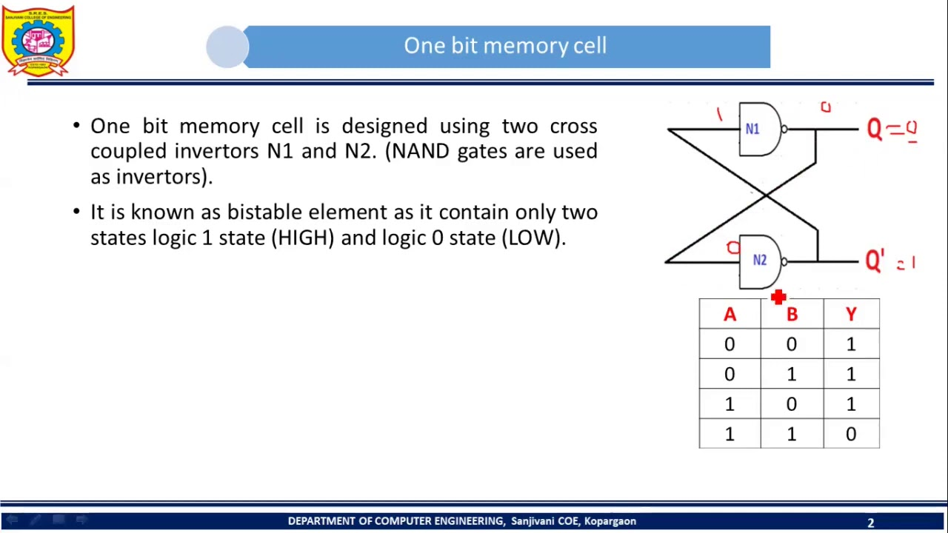

Slide 14
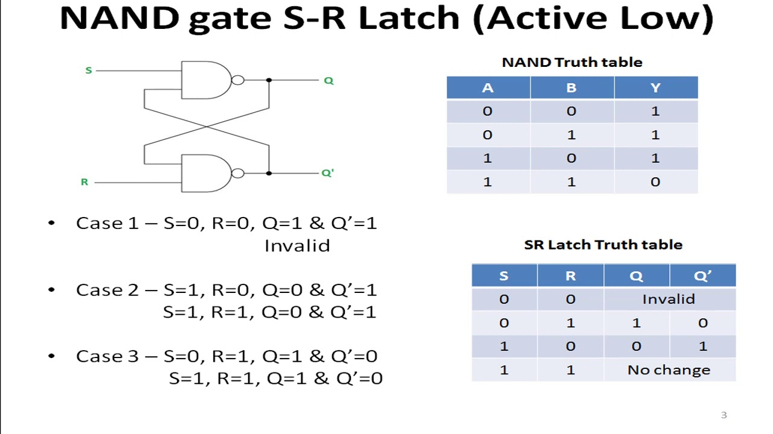

Slide 15
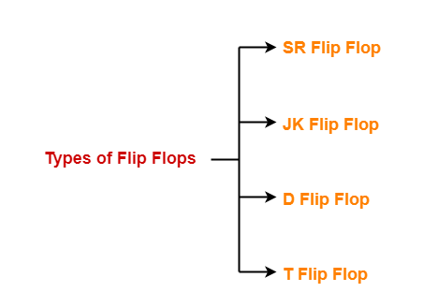
Flip Flops Types-
Flip flops are of different types depending on how their inputs and clock pulses cause transition between two states.
There are 4 basic types of flip flops-

Slide 16
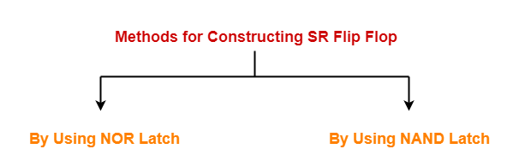
SR Flip Flop-
SR flip flop is the simplest type of flip flops.
It stands for Set Reset flip flop.
It is a clocked flip flop.
Construction of SR Flip Flop-
There are following two methods for constructing a SR flip flop-

Slide 17
SR Flip Flop:
The SR flip flop is a 1-bit memory bistable device having two inputs, i.e., SET and RESET. The SET input 'S' set the device or produce the output 1, and the RESET input 'R' reset the device or produce the output 0. The SET and RESET inputs are labeled as S and R, respectively.
The SR flip flop stands for "Set-Reset" flip flop. The reset input is used to get back the flip flop to its original state from the current state with an output 'Q'. This output depends on the set and reset conditions, which is either at the logic level "0"
The NAND gate SR flip flop is a basic flip flop which provides feedback from both of its outputs back to its opposing input. This circuit is used to store the single data bit in the memory circuit. So, the SR flip flop has a total of three inputs, i.e., 'S' and 'R', and current output 'Q'. This output 'Q' is related to the current history or state. or "1".

Slide 18
The NAND Gate SR Flip-Flop
We can implement the set-reset flip flop by connecting two cross-coupled 2-input NAND gates together.
In the SR flip flop circuit, from each output to one of the other NAND gate inputs, feedback is connected. So, the device has two inputs, i.e., Set 'S' and Reset 'R' with two outputs Q and Q' respectively. Below are the block diagram and circuit diagram of the S-R flip flop.
An important point about NAND gate is that its dominating input is 0 i.e., if any of its input is Logic ‘0’, the output is Logic ‘1’, irrespective of the other input. The output is 0, only if all the inputs are 1.

Slide 19
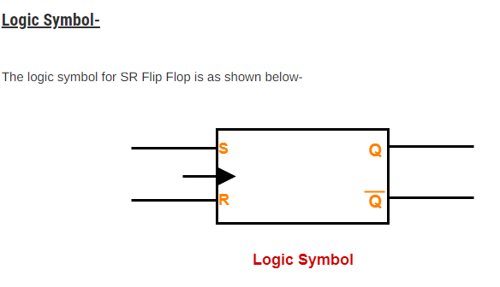

Slide 20
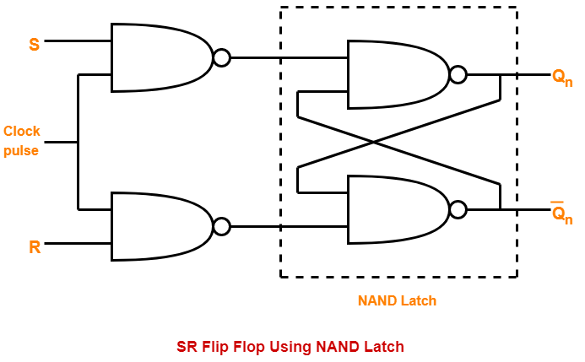
The logic circuit for SR Flip Flop constructed using NAND latch is as shown below-

Slide 21
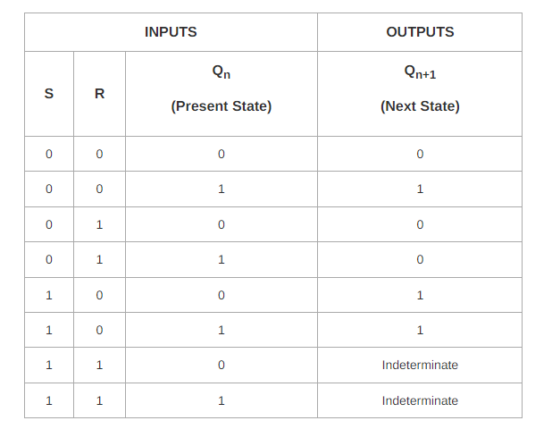
The truth table for SR Flip Flop is as shown below-

Slide 22
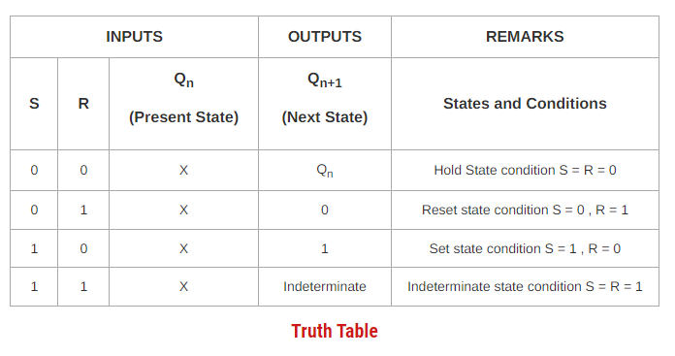
The above truth table may be reduced as-

Slide 23
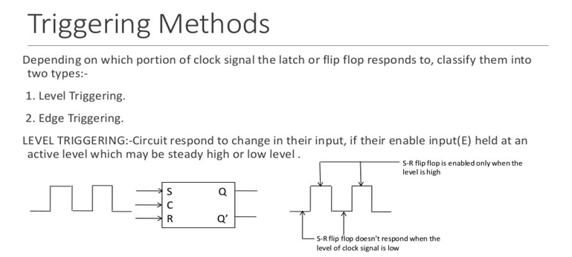
Latches Vs. Flip-Flop

Slide 24
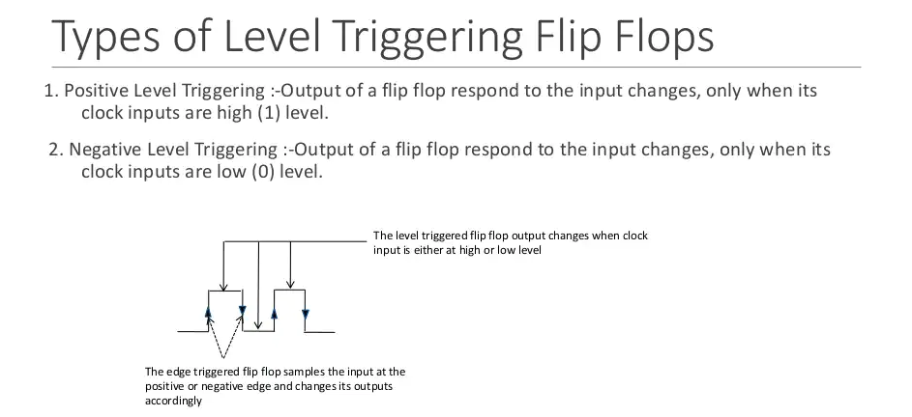

Slide 25
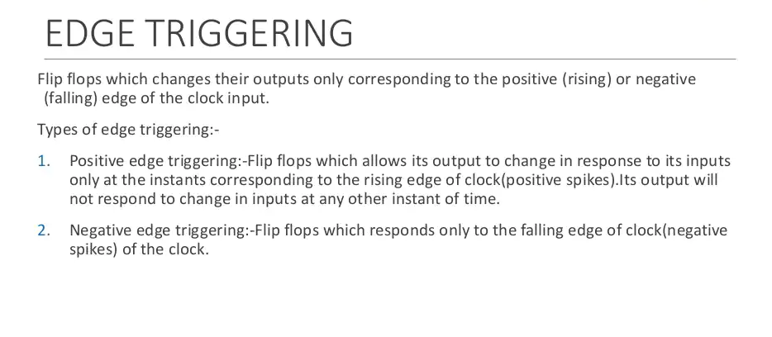

Slide 26
JK Flip Flop-
JK flip flop is a refined & improved version of SR Flip Flop that has been introduced to solve the problem of indeterminate state that occurs in SR flip flop when both the inputs are 1.
In JK flip flop,
Input J behaves like input S of SR flip flop which was meant to set the flip flop.
Input K behaves like input R of SR flip flop which was meant to reset the flip flop.

Slide 27
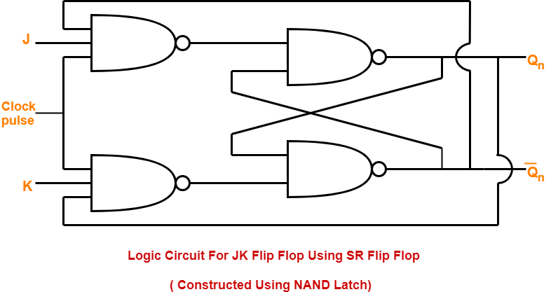

Slide 28
Truth table
INPUTS |  |  | OUTPUTS
J | K | Q_{n} (Present State) | Q_{n+1} (Next State)
0 | 0 | 0 | 0
0 | 0 | 1 | 1
0 | 1 | 0 | 0
0 | 1 | 1 | 0
1 | 0 | 0 | 1
1 | 0 | 1 | 1
1 | 1 | 0 | 1
1 | 1 | 1 | 0

Slide 29
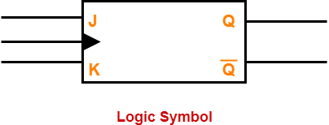
INPUTS |  |  | OUTPUTS | REMARKS
J | K | Q_{n} (Present State) | Q_{n+1} (Next State) | States and Conditions
0 | 0 | X | Q_{n} | Hold State condition J = K = 0
0 | 1 | X | 0 | Reset state condition J = 0 , K = 1
1 | 0 | X | 1 | Set state condition J = 1 , K = 0
1 | 1 | X | Q’_{n} | Toggle state condition

Slide 30
Points to Remember:
Both JK flip flop and SR flip flop are functionally same.
The only difference between them is-
In JK flip flop, indeterminate state does not occur.
In JK flip flop, instead of indeterminate state, the present state toggles.
In other words, the present state gets inverted when both the inputs are 1.

Slide 31
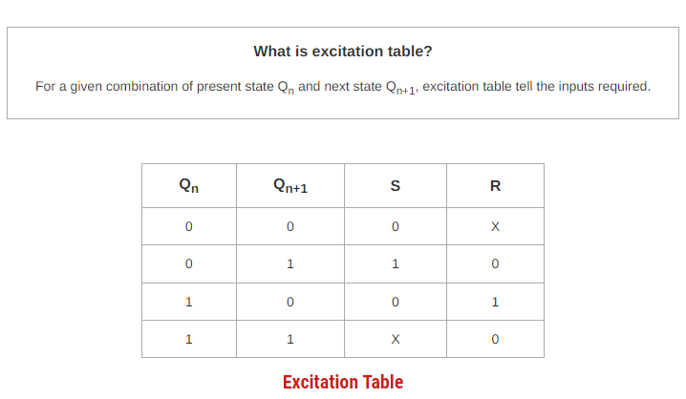
Excitation Table
The excitation table of any flip flop is drawn using its truth table.

Slide 32
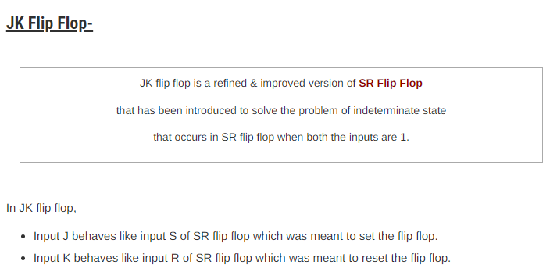

Slide 33
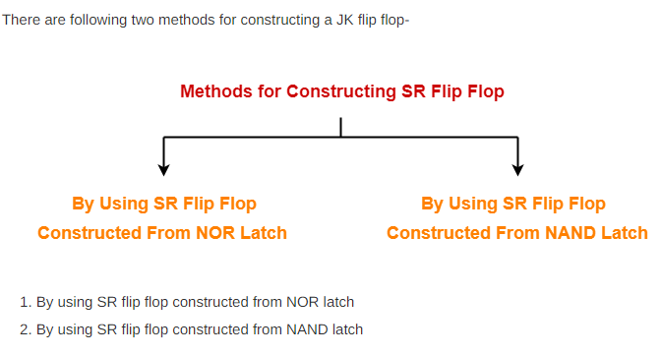

Slide 34
Construction of JK Flip Flop By Using SR Flip Flop Constructed From NOR Latch-
This method of constructing JK Flip Flop uses-
SR Flip Flop constructed from NOR latch
Two other connections

Slide 35
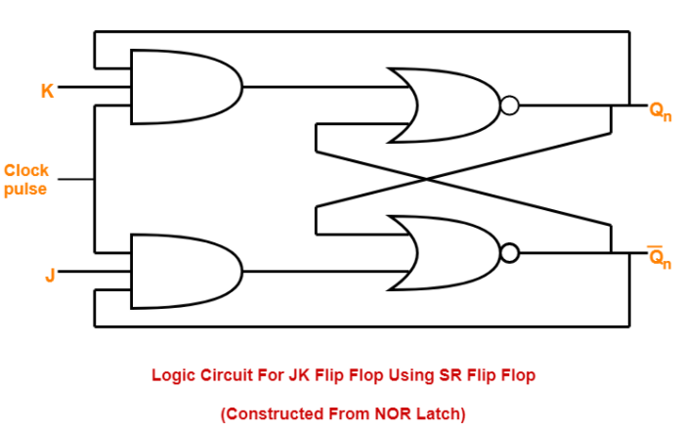
Logic Circuit- The logic circuit for JK Flip Flop constructed using SR Flip Flop constructed from NOR latch is as shown below-

Slide 36
Construction of JK Flip Flop By Using SR Flip Flop Constructed From NAND Latch-
This method of constructing JK Flip Flop uses-
SR Flip Flop constructed from NAND latch
Two other connections

Slide 37
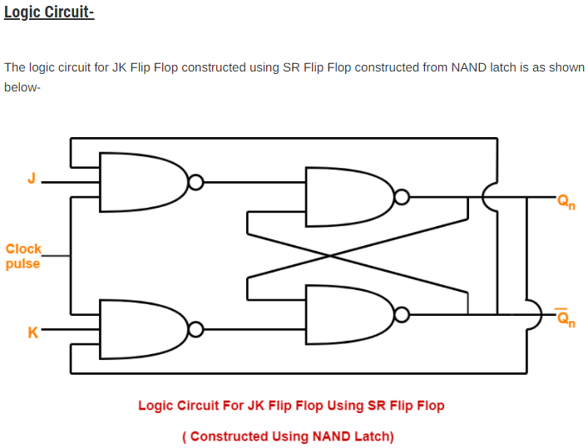

Slide 38
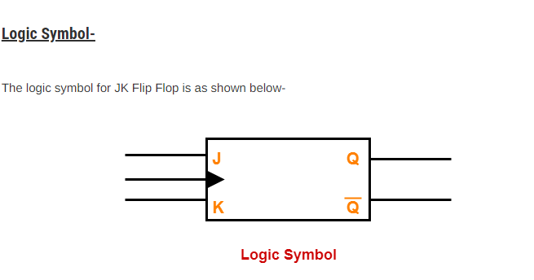

Slide 39
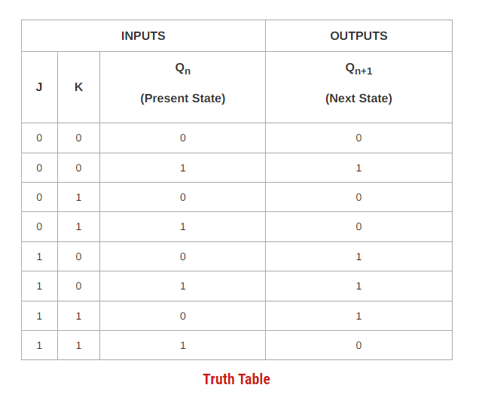
The truth table for JK Flip Flop is as shown below-

Slide 40
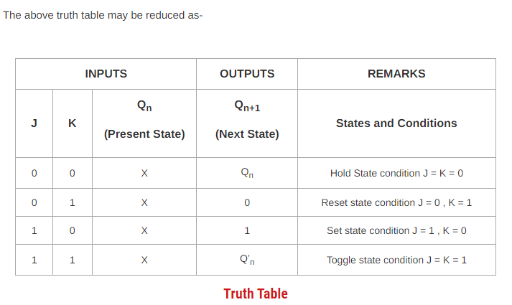

Slide 41
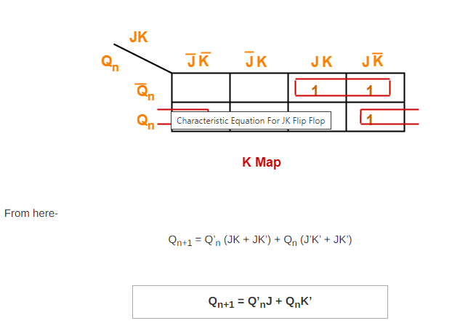
Characteristic Equation- Draw a k map using the above truth table-

Slide 42
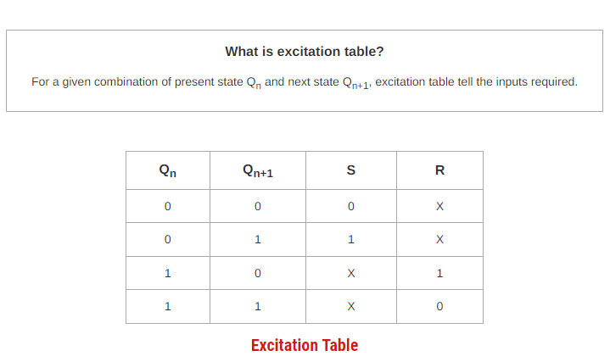
Excitation Table- The excitation table of any flip flop is drawn using its truth table.

Slide 43
SR Flip Flop Vs JK Flip Flop
Both JK flip flop and SR flip flop are functionally same.
The only difference between them is-
In JK flip flop, indeterminate state does not occur.
In JK flip flop, instead of indeterminate state, the present state toggles.
In other words, the present state gets inverted when both the inputs are 1.

Slide 44
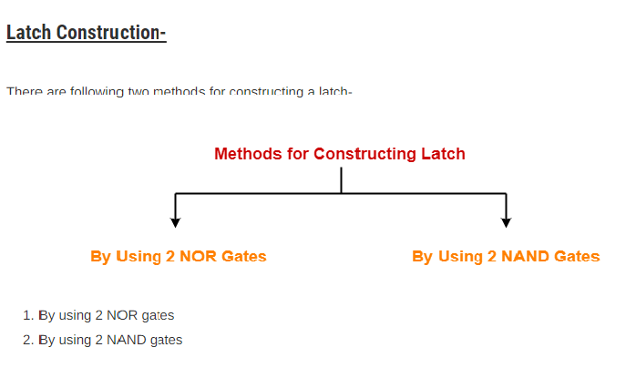
Latch-
A latch is basically an unclocked flip flop or a latch is the basic building block using which clocked flip flops are constructed.

Slide 45
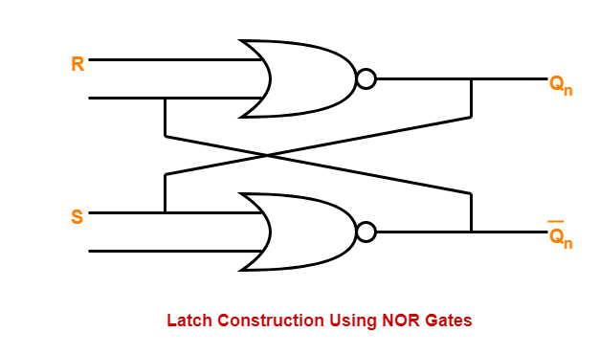
Construction Of Latch By Using 2 NOR Gates-
Logic Circuit- The logic circuit for a latch constructed using NOR gates is as shown below-
While constructing a latch using NOR gates, it is compulsory to consider-
Reset input R in normal output Q_{n}.
Set input S in complemented output Q’_{n}.

Slide 46
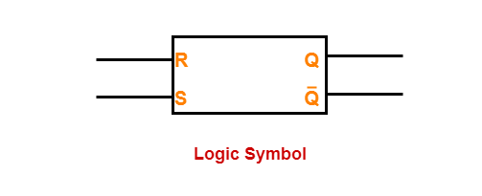
Logic Symbol-
The logic symbol for a latch constructed using NOR gates is as shown below-

Slide 47
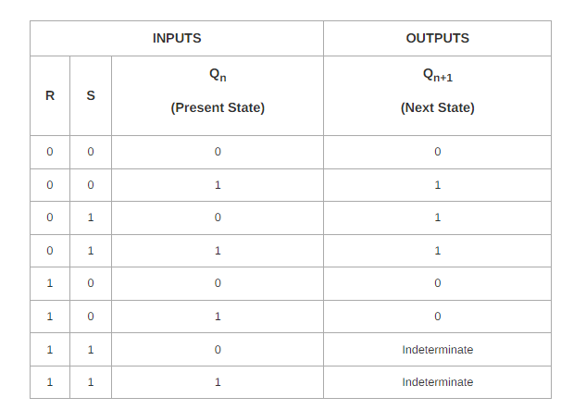
The truth table for a latch constructed using NOR gates is as shown below-

Slide 48
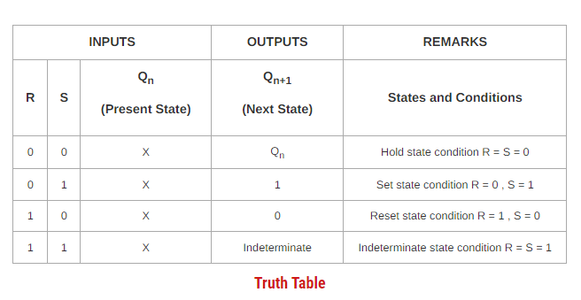
The above truth table may be reduced as-

Slide 49
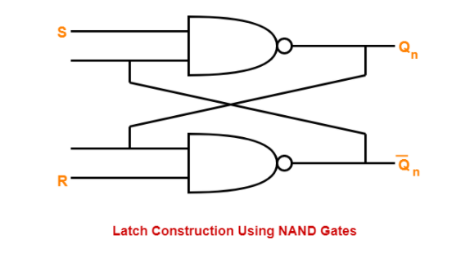
Construction Of Latch By Using 2 NAND Gates-
Logic Circuit-
The logic circuit for a latch constructed using NAND gates is as shown below-

Slide 50
While constructing a latch using NAND gates, it is compulsory to consider-
Set input S in normal output Q_{n}.
Reset input R in complemented output Q’_{n}.

Slide 51
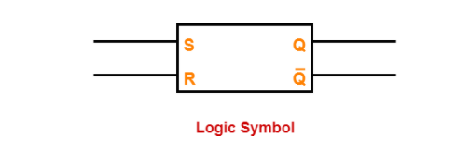
Logic Symbol- The logic symbol for a latch constructed using NAND gates is as shown below-

Slide 52
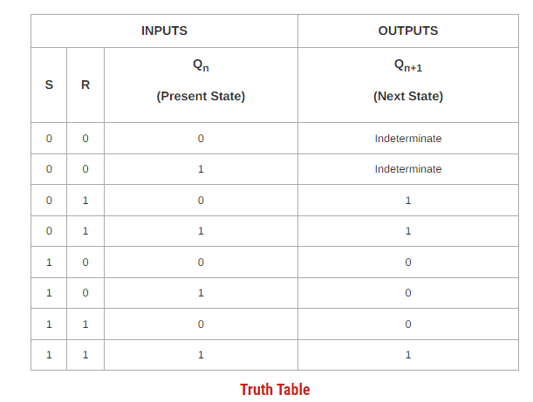
The truth table for a latch constructed using NAND gates is as shown below-

Slide 53
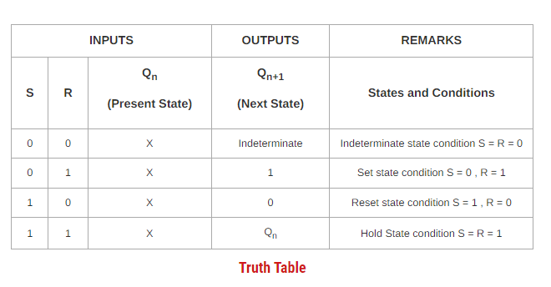
The above truth table may be reduced as-

Slide 54
D flip flops
A D (or Delay) Flip Flop is a digital electronic circuit used to delay the change of state of its output signal (Q) until the next rising edge of a clock timing input signal occurs.

